Slide 1
Lecture
Access – Forms

Slide 2
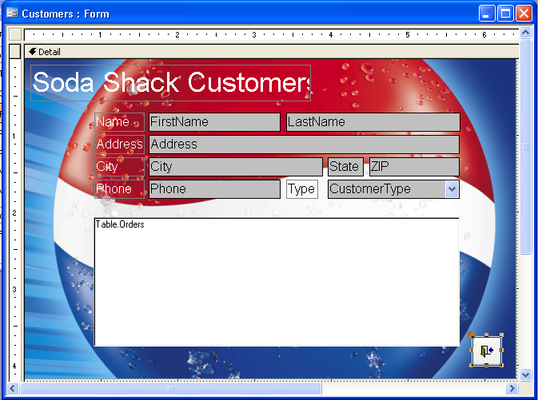
What’s a Form?
Easier way to get to your data
  Add
  Change
  Delete
More secure
  Users see only what you want
Additional features
  Add programming

Slide 3
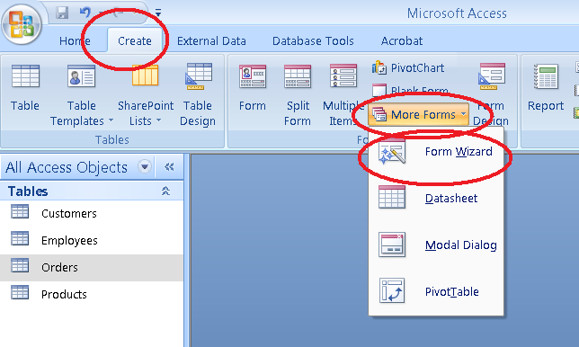
Creating a form in the Wizard

Slide 4
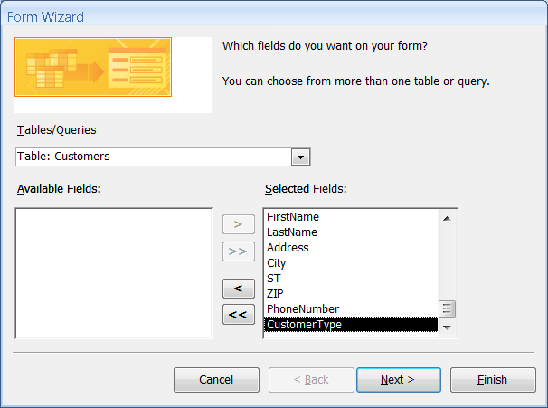
Creating a form in the Wizard

Slide 5
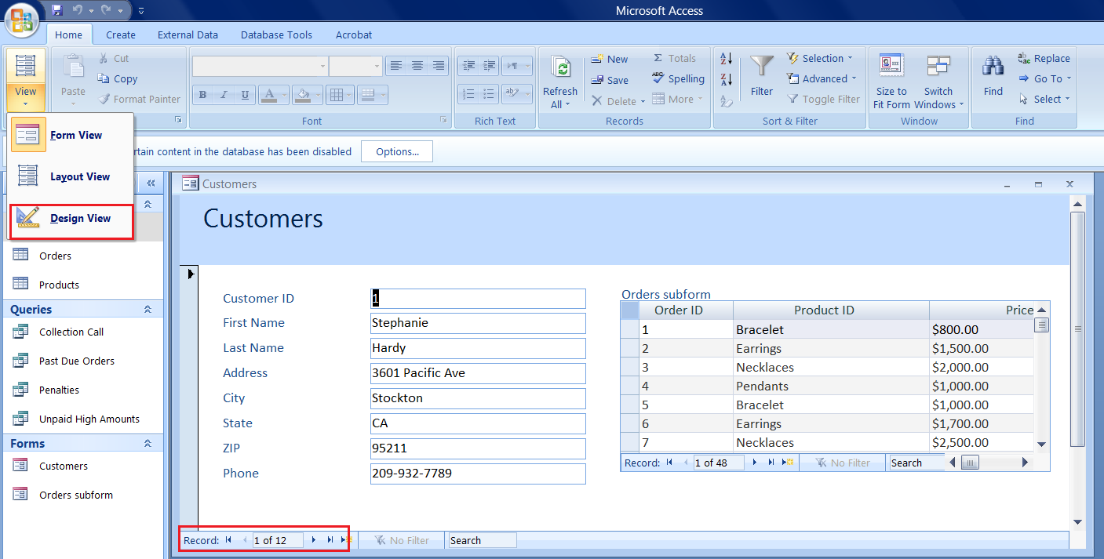
Parts of a Form
design mode
fields
labels
sub form
navigation
new record

Slide 6
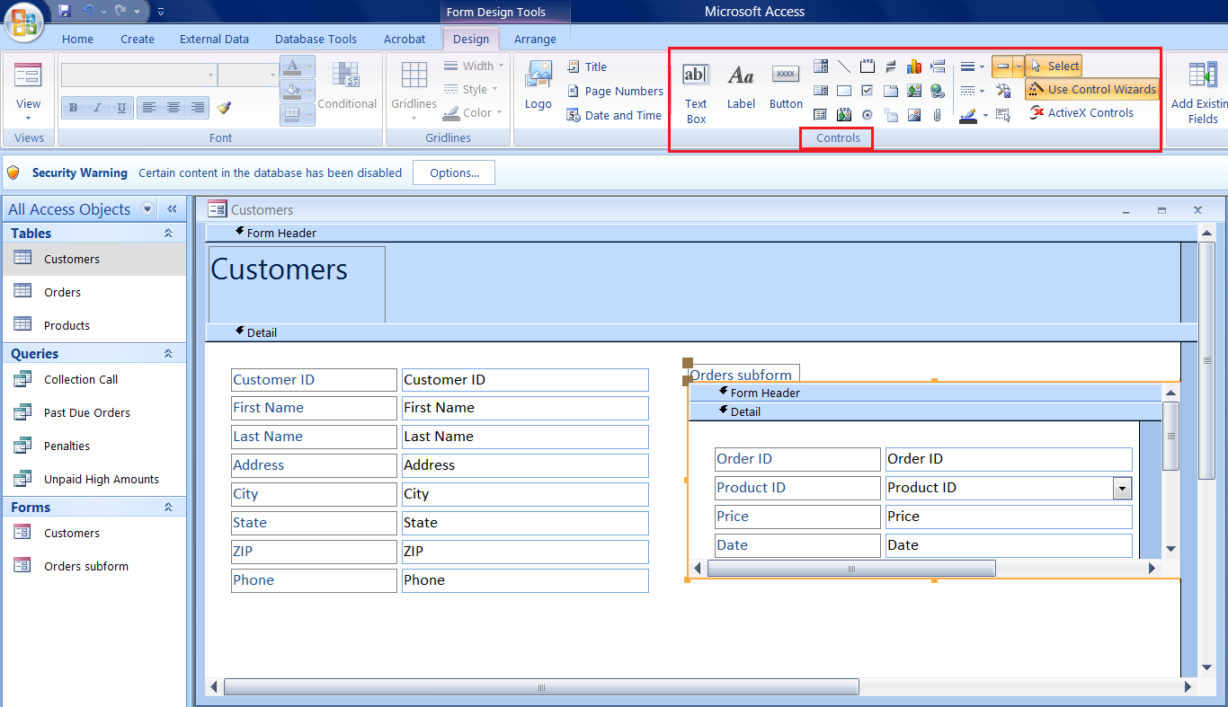
Designing Your Form
Font, size, color, etc..
add a control
Click on controls to resize, move, or edit
Right-click and choose properties for more options

Slide 7
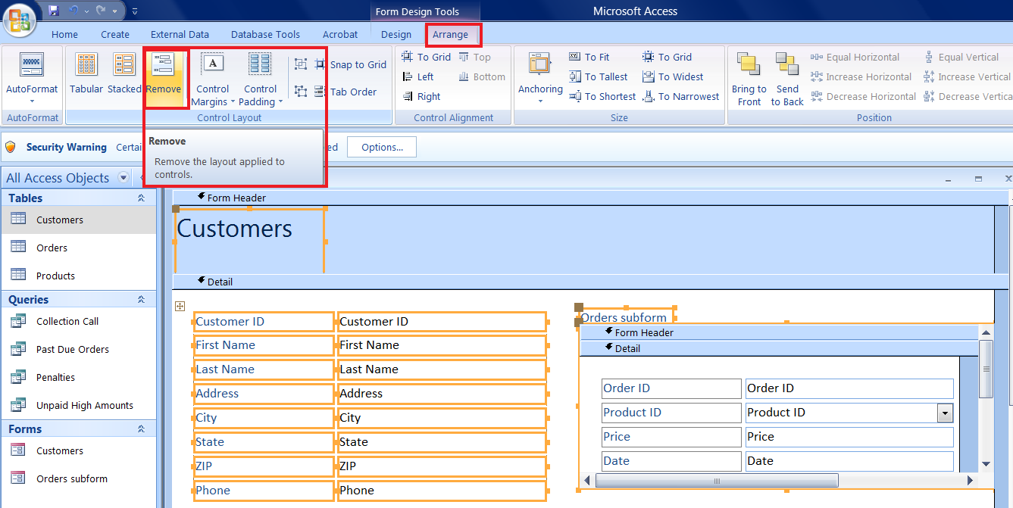
Removing Control Layout
Select All: CTRL + A
Arrange | Remove

Slide 8
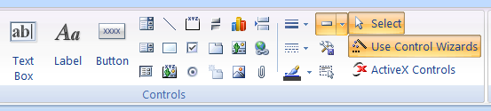
Designing Your Form
add a label
Add a button
Add a line
Line colors and fill
Add a picture or logo
Add a SubForm

Slide 9
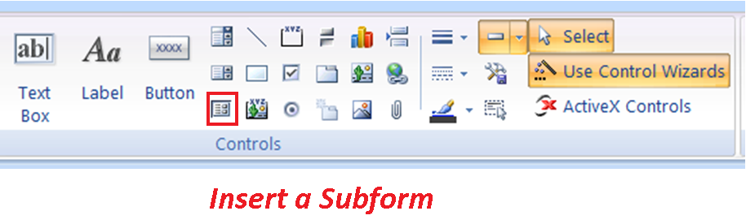
Adding a SubForm
Size your controls and palette and create enough room for an additional form.
Click once on the SubForm/SubReport icon:

Slide 10
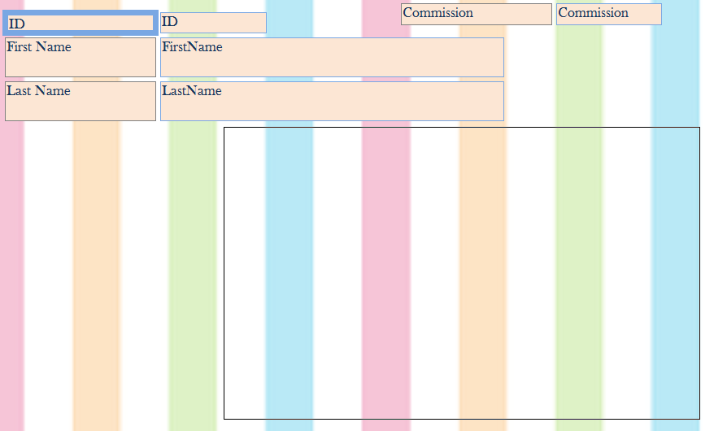
SubForms…con’t
Point, Click, Drag your subform into your existing form

Slide 11
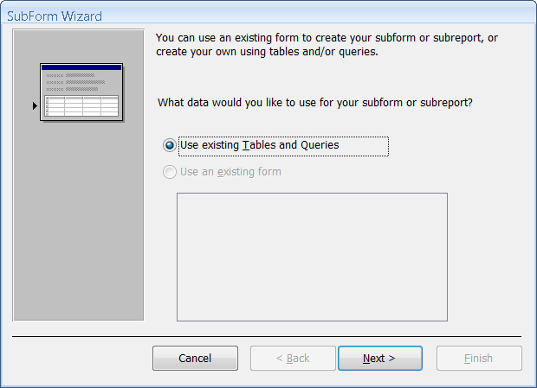
The follow the SubForm Wizard!

Slide 12
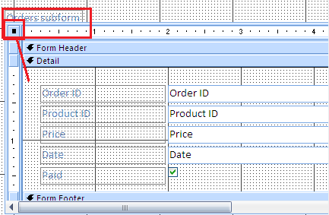
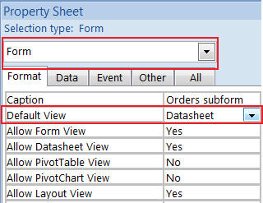
Converting Datasheet to Form
Datasheets have no formatting – only forms can have graphics
Convert to Form
Click Select
Form button
Properties
Change datasheet
to Single Form

Slide 13
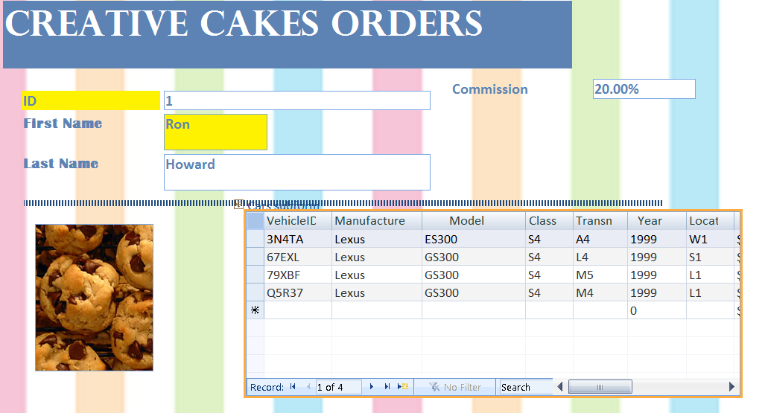
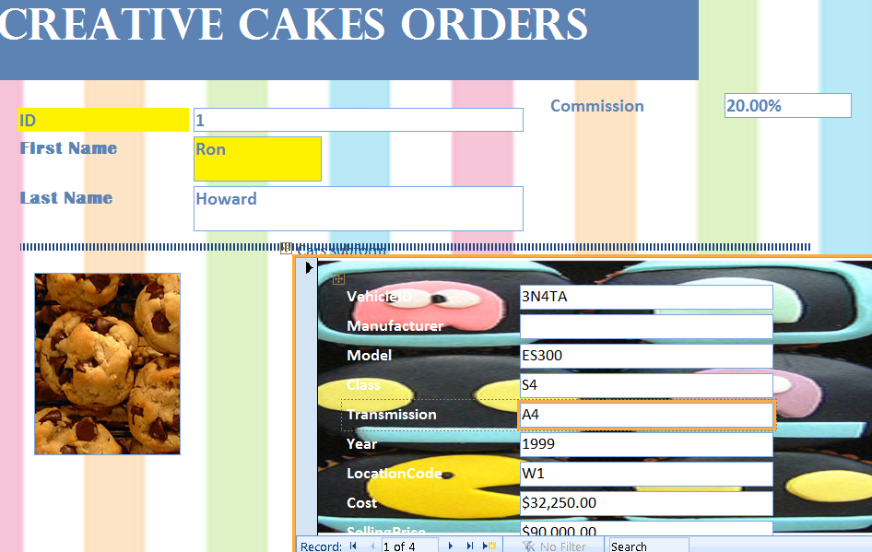
Datasheet vs Single Form View

Slide 14
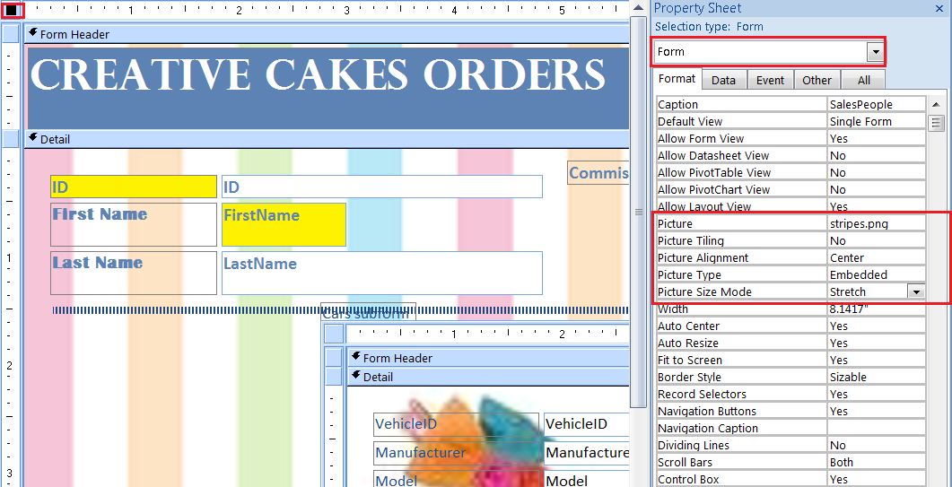
Adding Background Pictures
Must be in Form Properties

Slide 15
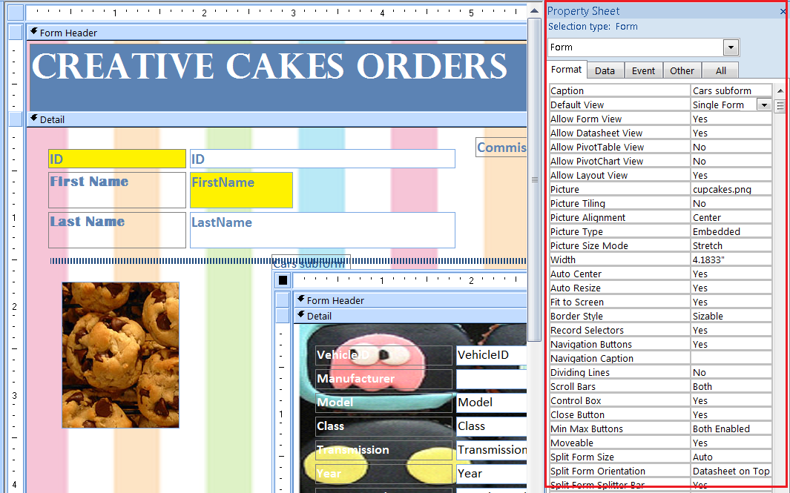
Properties
Every Object & Control has it’s own properties

Slide 16
Compressing the Database
Pictures (logos/photos) and deleted data can make the database file huge
Periodically compress the database to keep the size down
Tools → Database Utilities → Compact and Repair

